Slide 1
Designing an
Experiment (in 2 parts)
13
Probability
and
Statistics
COMS10011
Dr. Anne Roudaut
csxar@bristol.ac.uk

Slide 2
Part 1

Slide 3
let’s do an experiment!

Slide 4
memorization game
group 1
memorize as much
as you can
group 2
if you beat group 1 = chocolate!

Slide 5
take a piece of paper and a pen

Slide 6

I will tell a list of numbers
“1,2,3,6,write”
only when “write” -> write the list on paper
I will show the list
1, 2, 3, 6
if you are correct continue the game
if you wrong stop the game, remember best score

Slide 7
practice trials
1, 4, 9 (size=3)

Slide 8
practice trials
8, 7, 3, 5, 6, 1 ,2 (size=7)

Slide 9
practice trials
8, 7, 1 ,2, 3, 4, 5, 1, 6, 7, 2, 9, 6 ,1 (size=15)

Slide 10
let’s start the real experiment!

Slide 11
trial
3, 2, 8 (size=3)

Slide 12
trial
4, 2, 5, 1 (size=4)

Slide 13
trial
7, 2, 5, 3, 1 (size=5)

Slide 14
trial
6, 2, 9, 8, 5, 1 (size=6)

Slide 15
trial
7, 4, 1, 8, 6, 3, 2 (size=7)

Slide 16
trial
2, 7, 4, 9, 3, 1, 5, 9 (size=8)

Slide 17
trial
1, 6, 7, 8, 5, 3, 1, 4, 6 (size=9)

Slide 18
trial
6, 4, 1, 9, 3, 8, 2, 1, 7, 9 (size=10)

Slide 19
trial
2, 7, 4, 1, 5, 7, 3, 8, 6, 4, 7 (size=11)

Slide 20
what is your best score (size of the list)?
enter it at
https://tinyurl.com/COMS10011

Slide 21
let’s first look at the results

Slide 22
1
5
research question / hypothesis?
look at raw data
2
6
in(dependant) variables?
look at distributions
3a
within or between subjects?
7a
check for normality
3b
counterbalancing?
7b
run some stats
4
8
how many repetitions/trials?
conclude

Slide 23
5
look at raw data

Slide 24
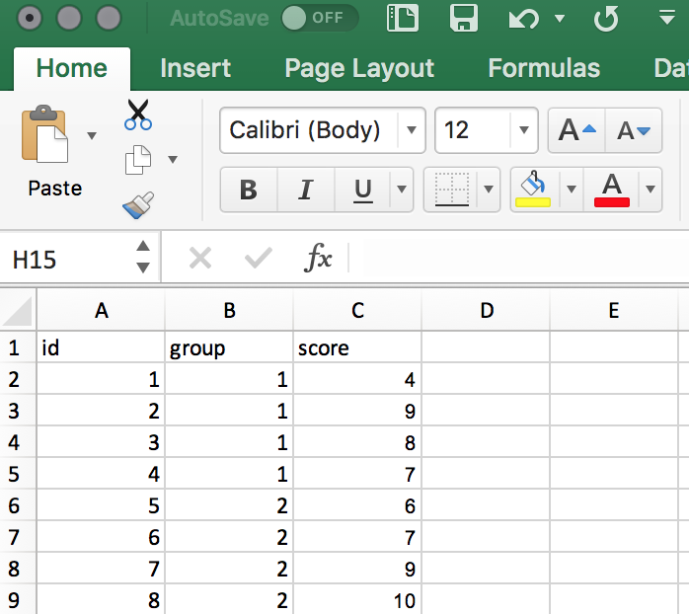
let’s put everything in a table (excel is great for that)

Slide 25
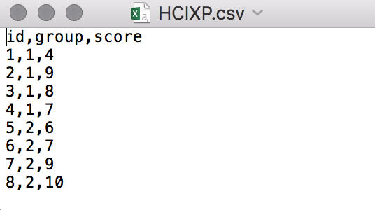
save your file as a .csv (comma separated virgule is a format to store tables as text files)
you can open csv with excel, text file an many other software

Slide 26
R
dat = read.csv("HCIXP.csv", header = TRUE)
print(dat) # look at the file in R
Notes:
head(cars) # cars is a table that already comes with R and contain 50 observations of speed and distance in two rows
scatter.smooth(x=cars$speed, y=cars$dist, main="Dist ~ Speed") # scatterplot
linearMod <- lm(dist ~ speed, data=cars) # build linear regression model on full data
summary(linearMod) # summary(linearMod)$r.squared
abline(linearMod, col="blue")

Slide 27
R
dat = read.csv("HCIXP.csv", header = TRUE)
print(dat) # look at the file in R
library(ggplot2)
ggplot(dat, aes(x = dat$id, y = dat$score)) + geom_bar(stat = 'identity', position = 'dodge')
Notes:
head(cars) # cars is a table that already comes with R and contain 50 observations of speed and distance in two rows
scatter.smooth(x=cars$speed, y=cars$dist, main="Dist ~ Speed") # scatterplot
linearMod <- lm(dist ~ speed, data=cars) # build linear regression model on full data
summary(linearMod) # summary(linearMod)$r.squared
abline(linearMod, col="blue")

Slide 28
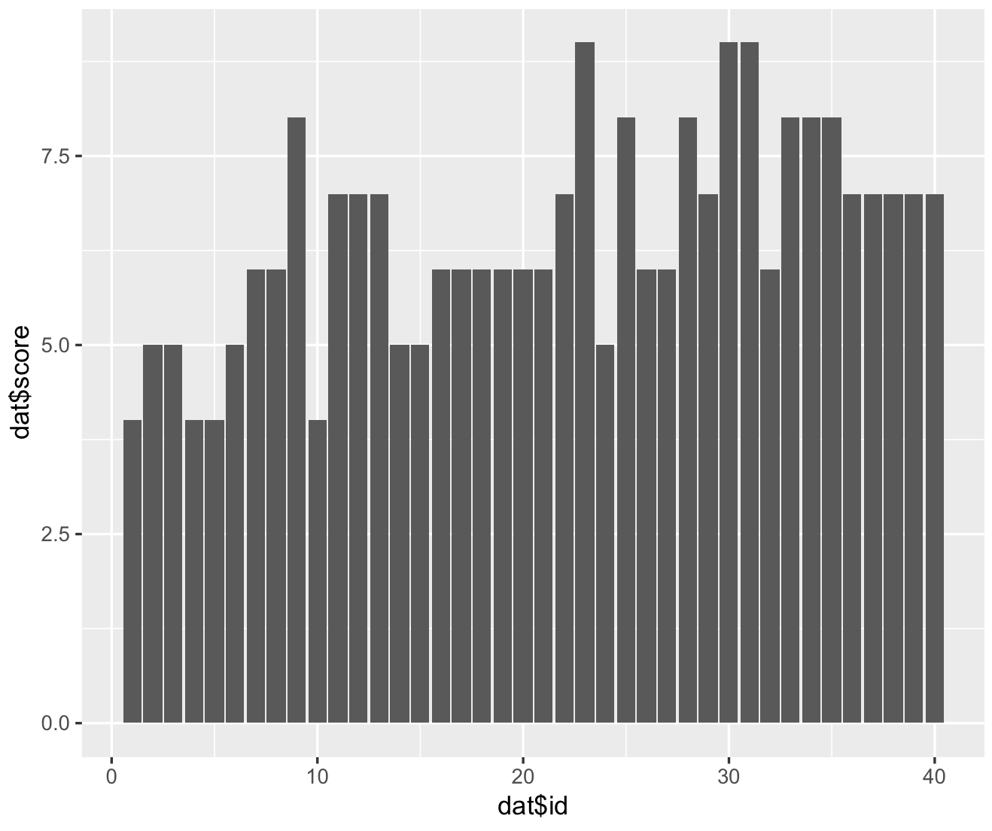
first: does the data look ok?
search for bugs, fatigue effect, learning effect or outliers (>3 times std) = remove / redo xp

Slide 29
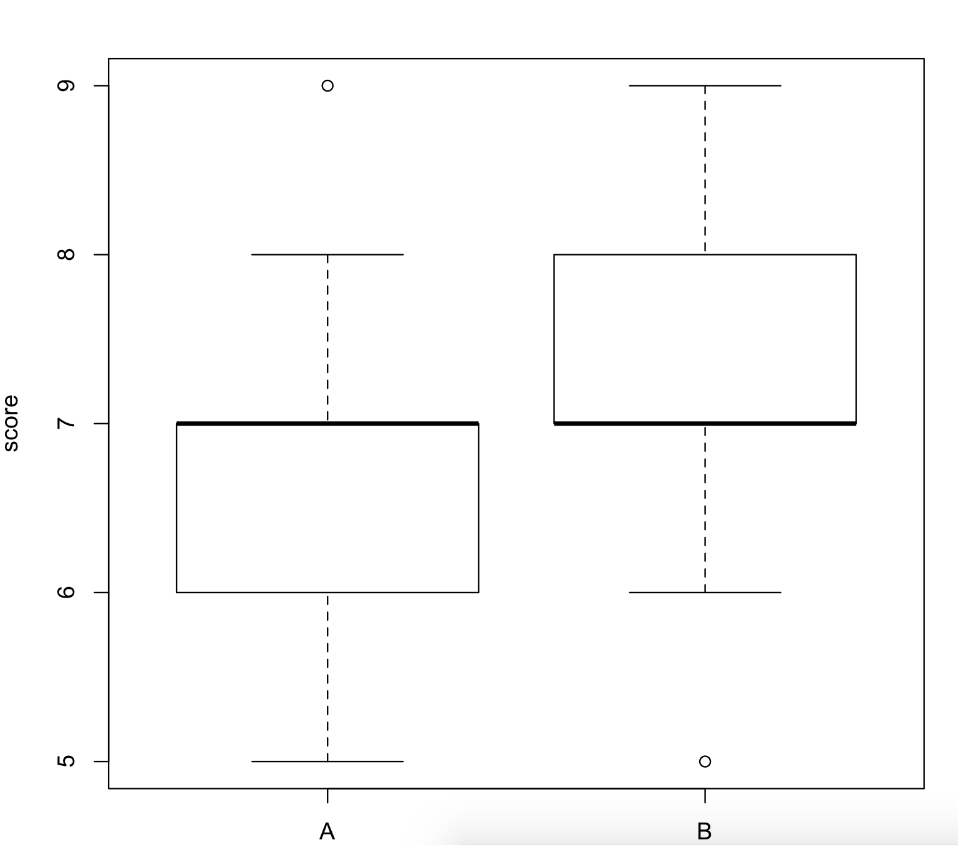
R
plot(score ~ group, data = dat)
Notes:
head(cars) # cars is a table that already comes with R and contain 50 observations of speed and distance in two rows
scatter.smooth(x=cars$speed, y=cars$dist, main="Dist ~ Speed") # scatterplot
linearMod <- lm(dist ~ speed, data=cars) # build linear regression model on full data
summary(linearMod) # summary(linearMod)$r.squared
abline(linearMod, col="blue")

Slide 30
6
look at histograms

Slide 31
R
# Find the mean of each group
library(plyr)
cdat <- ddply(dat, "group", summarise, score.mean=mean(score))
cdat
group score.mean
1 A 5.60
2 B 7.25
# Overlaid histograms with means
ggplot(dat, aes(x=score, fill=group)) + geom_histogram(binwidth=1, alpha=.3, position="identity") + geom_vline(data=cdat, aes(xintercept=score.mean, colour=group), linetype="dashed", size=1) + expand_limits(x = 0, y = 0)
Notes:
head(cars) # cars is a table that already comes with R and contain 50 observations of speed and distance in two rows
scatter.smooth(x=cars$speed, y=cars$dist, main="Dist ~ Speed") # scatterplot
linearMod <- lm(dist ~ speed, data=cars) # build linear regression model on full data
summary(linearMod) # summary(linearMod)$r.squared
abline(linearMod, col="blue")

Slide 32
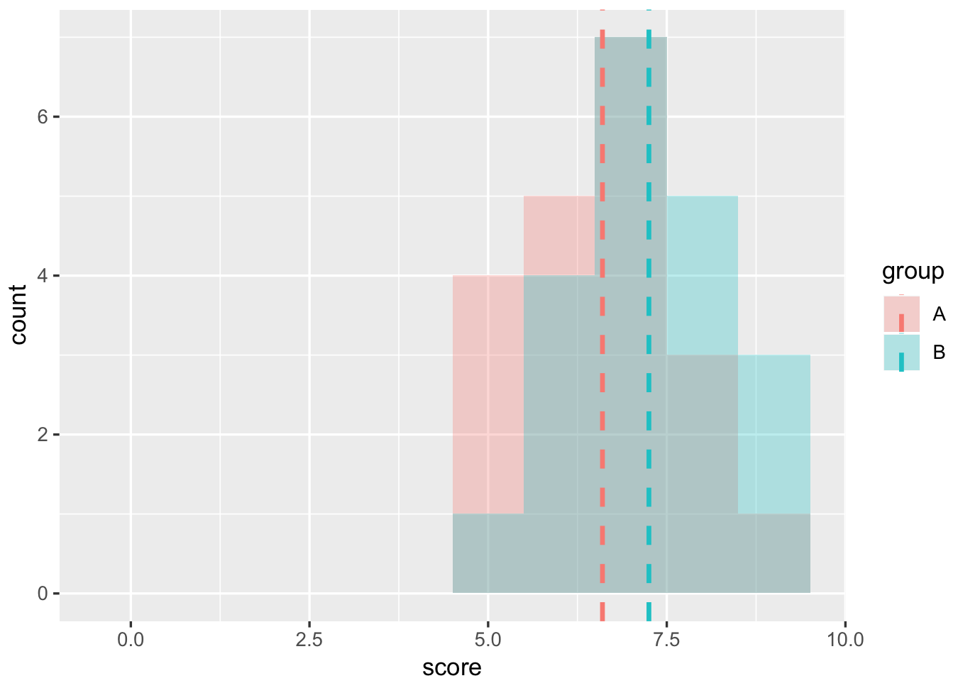
your gut feeling: are these groups different?
are these distributions likely to have happen by chance?
… is this the results of the factor (chocolate)?

Slide 33
7
use a statistic test

Slide 34
R
# Use a t-test (two-tails, unpaired)
t.test(dat$score[dat$group == "A"], dat$score[dat$group =="B"], alternative = "two.sided")
Welch Two Sample t-test
data: dat$score[dat$group == "A"] and dat$score[dat$group == "B"]
t = -1.8185, df = 37.982, p-value = 0.07688
alternative hypothesis: true difference in means is not equal to 0
95 percent confidence interval:-1.37361001 0.07361001
sample estimates: mean of x mean of y 6.60 7.25
“We could not find any significance differences!”
Notes:
head(cars) # cars is a table that already comes with R and contain 50 observations of speed and distance in two rows
scatter.smooth(x=cars$speed, y=cars$dist, main="Dist ~ Speed") # scatterplot
linearMod <- lm(dist ~ speed, data=cars) # build linear regression model on full data
summary(linearMod) # summary(linearMod)$r.squared
abline(linearMod, col="blue")

Slide 35
p-value = 0.07
is is enough to say that the two groups are different?
-> nope, not under significant level of 0.05
can we say that the two groups are same then?
-> nope, can only prove things are different, but not that they are the same

Slide 36
8
conclude

Slide 37
if p was lower than significance level we could say:
“a student t-test showed significant difference between the two group (two-tailed t(46)=4.520, p < 0.005)”
otherwise:
“we did not find any significant results”
cannot conclude, no evidences to show that having chocolate rewards improve memorisation

Slide 38
let’s go backward a little

Slide 39
1
5
research question / hypothesis?
look at raw data
2
6
in(dependant) variables?
look at distributions
3a
within or between subjects?
7a
check for normality
3b
counterbalancing?
7b
run some stats
4
8
how many repetitions/trials?
conclude

Slide 40
1
research question::
a statement that identifies a phenomenon to be studied
in our xp: I believe that rewards improve memorization skills
… suggested by <insert smart guess>

Slide 41
hypotheses::
statement of the predicted relationship between at least two experimental variables
provisional answer to a research question
in our xp: group chocolate will have a higher memorisation score than group with no reward

Slide 42
2
(in)dependent variable ::
the dependent variable is the event studied and expected to change whenever the independent variable is altered

Slide 43
so we want to show that A causes B
vary A → make A an independent variable
measure B → make B a dependent variable

Slide 44
in our xp?
independent variable = group type (nothing vs. chocolate)
dependent variable = memorization score

Slide 45
everything else should be a…

Slide 46
controlled variable ::
the variables that are kept constant to prevent their influence on the effect of the independent variable on the dependent

Slide 47
avoid…
confounding variable ::
extraneous variables that correlates with both the dependent variable and the independent variable

Slide 48
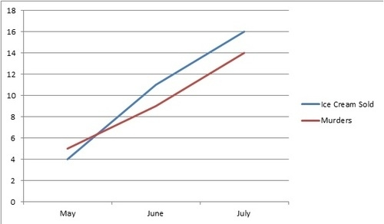
ice cream consumption leads to murder
counfounding : weather temperature

Slide 49
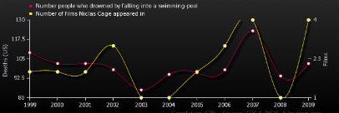
number of people drowned by falling into a swimming-pool correlates with number of films Nicolas Cage appeared in

Slide 50
this is not about correlation
this is about how to show causality, i.e., that some A causes some B

Slide 51
in our xp, do we have confounding variables?
yes, it is not greatly designed :s
gender, age, background, what you ate before, if you like chocolate or not, if you are competitive and want the others not to have chocolate, if some of the numbers are familiar to you etc.
what can we do about it?
avoid them by controlling as much as you can in the environment
if you cannot, make it an independent variable (e.g. gender)
some are inherent noise (human individuality), use more participants to get statistical power

Slide 52
the goal of a quantitative study is to find a signal in a lot of noise

Slide 53
experimental design:
aims at maximizing your chances of finding the signal and not the noise

Slide 54
need to absolutely avoid systematic biases
(e.g., learning effect, fatigue). They give you false results!
2. avoid random noise. It makes your results non-significant. Clever experimental design is all about keeping the noise down

Slide 55
e.g. in our xp, I made you practice before!

Slide 56
3
a
within vs. between?
within = all participants do same
between = participants do only certain conditions

Slide 57
3
a
within vs. between?
within = all participants do same
between = participants do only certain conditions
suffer less user variation
statistical power with less participants
no biases from other conditions (e.g. transfer of learning)

Slide 58
in our xp, it had to be between subjects
(because of the rewards)
participants did not do all conditions:
½ did the control condition
½ the reward condition

Slide 60

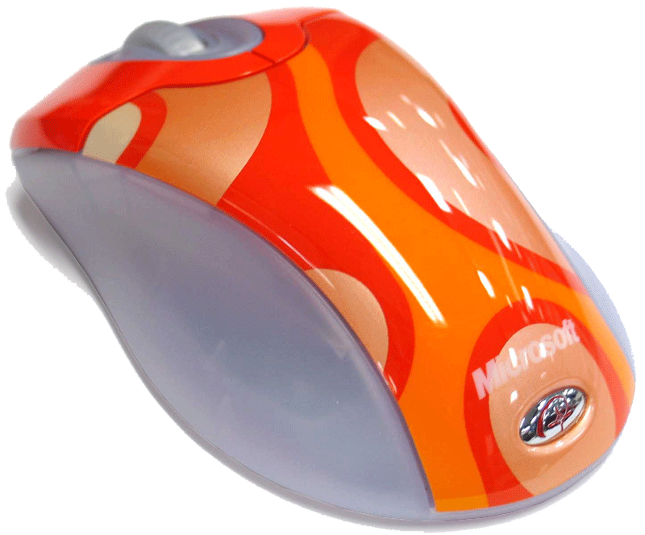
imagine a within subjects (test how fast we click an icon):
participants do all conditions:
they start with the trackpad
when finished they do the mouse
is it a good idea?
nope -> learning effect

Slide 61
3
b
counterbalancing ::
a method of avoiding confounding among variables
presenting conditions in a different order

Slide 62
one approach to counterbalancing is to use a…

Slide 63


Latin square ::
an n × n array filled with n different Latin letters, each occurring exactly once in each row and exactly once in each column.

Slide 65
4
how many trials?
ideally make as much trials as you can to reduce noise but try to keep experiment around 30 min … max 40 min

Slide 66
in our xp, we did only one trial because of time constraint, but should have done more to reduce noises

Slide 67
summary

Slide 68
1
5
research question / hypothesis?
look at raw data
2
6
in(dependant) variables?
look at distributions
3a
within or between subjects?
7a
we will see why
check for normality
3b
counterbalancing?
7b
run some stats
so far we know t-test
4
8
how many repetitions/trials?
conclude

Slide 69
end of part one

Slide 70
1
5
research question / hypothesis?
look at raw data
2
6
in(dependant) variables?
look at distributions
3a
within or between subjects?
7a
we will see why
check for normality
3b
counterbalancing?
7b
run some stats
so far we know t-test
4
8
how many repetitions/trials?
conclude

Slide 71
Part 2

Slide 72
Designing an
Experiment (in 2 parts)
13
Probability
and
Statistics
COMS10011
Dr. Anne Roudaut
csxar@bristol.ac.uk

Slide 73
1
5
research question / hypothesis?
look at raw data
2
6
in(dependant) variables?
look at distributions
3a
within or between subjects?
7a
we will see why
check for normality
3b
counterbalancing?
7b
run some stats
so far we know t-test
4
8
how many repetitions/trials?
conclude

Slide 74
P>0.05. We did not find evidences of statistically differences between the two groups chocolate vs. no chocolate

Slide 75
let’s complexify a little

Slide 76
in our xp, let’s add a 3rd imaginary group
they get a slap if they had the smallest memorisation score
(obviously not ethical so let’s keep this hypothetical!)

Slide 77
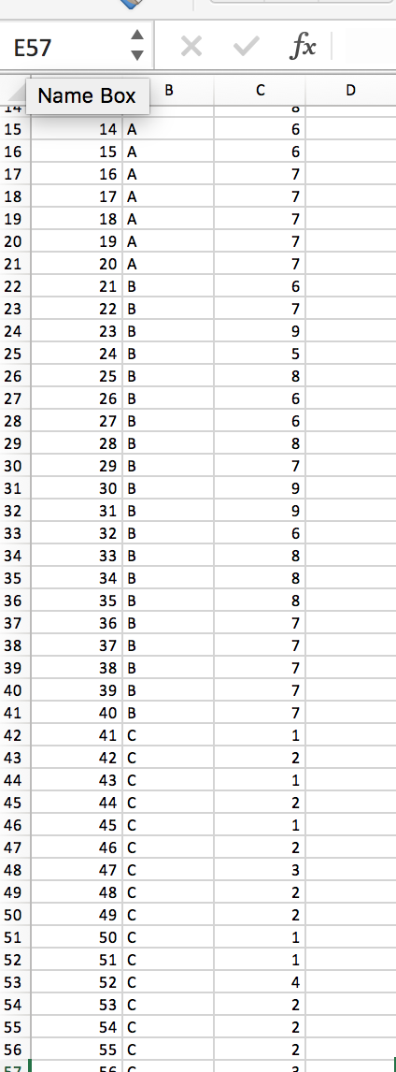
Group C: “slap”
I made up some data

Slide 78
R
# Find the mean of each group
dat = read.csv("HCIXP-anova.csv", header = TRUE)
cdat <- ddply(dat, "group", summarise, score.mean=mean(score))
cdat
group score.mean
1 A 6.60
2 B 7.25
3 C 1.95
# Overlaid histograms with means
ggplot(dat, aes(x=score, fill=group)) + geom_histogram(binwidth=1, alpha=.3, position="identity") + geom_vline(data=cdat, aes(xintercept=score.mean, colour=group), linetype="dashed", size=1) + expand_limits(x = 0, y = 0)
Notes:
head(cars) # cars is a table that already comes with R and contain 50 observations of speed and distance in two rows
scatter.smooth(x=cars$speed, y=cars$dist, main="Dist ~ Speed") # scatterplot
linearMod <- lm(dist ~ speed, data=cars) # build linear regression model on full data
summary(linearMod) # summary(linearMod)$r.squared
abline(linearMod, col="blue")

Slide 79
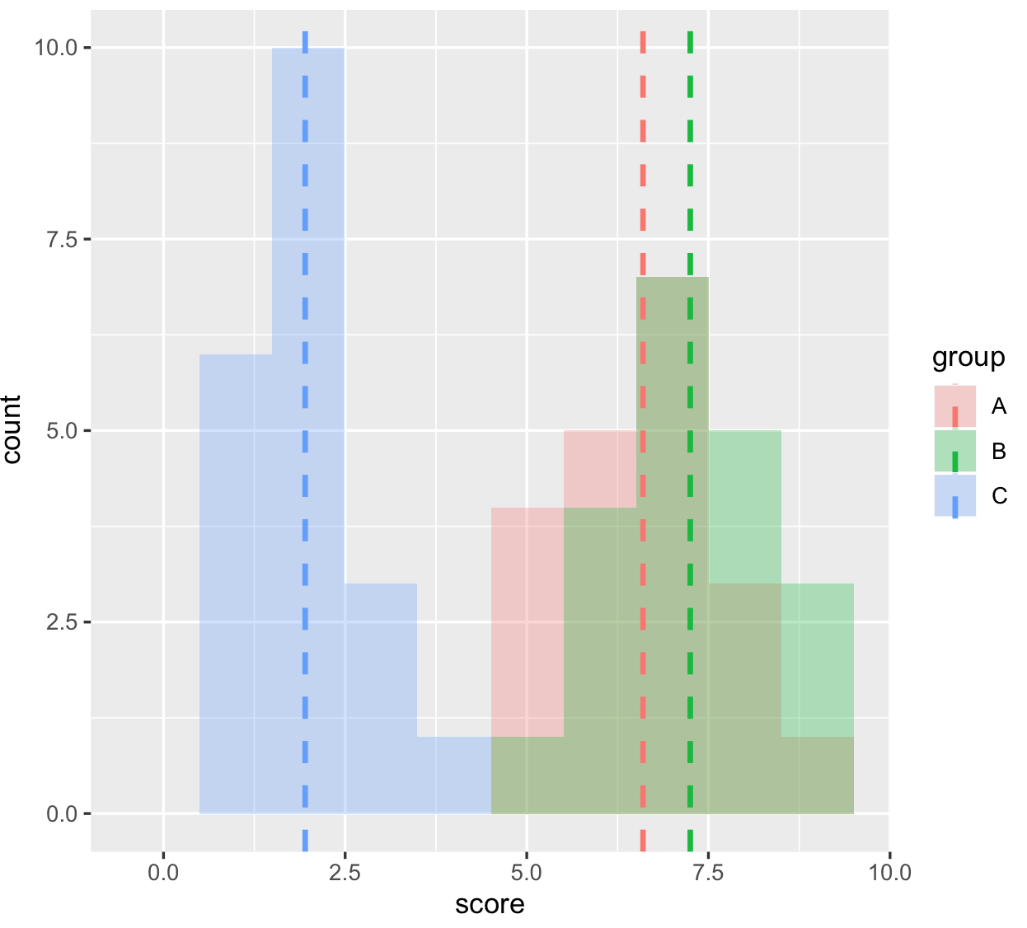
your gut feeling: are these groups different?
are these distributions likely to have happen by chance?

Slide 80
can we use t-tests?
(3 tests to compare group 1 with 2, 2 with 3 and 1 with 3)
-> yes but use Bonferoni correction
significance level not 0.05 anymore but 0.05 / number of comparisons performed (here 3) so 0.016

Slide 81
R
# Use a t-test (two-tails, unpaired)
# (we already know A vs B not significative) so we need to do
t.test(dat$score[dat$group == "A"], dat$score[dat$group == "C"], alternative = "two.sided")
t = 14.753, df = 34.591, p-value < 2.2e-16
# and
t.test(dat$score[dat$group == "B"], dat$score[dat$group == "C"], alternative = "two.sided")
t = 17.054, df = 34.971, p-value < 2.2e-16
In both case p_value < 0.016 so we can conclude!
Notes:
head(cars) # cars is a table that already comes with R and contain 50 observations of speed and distance in two rows
scatter.smooth(x=cars$speed, y=cars$dist, main="Dist ~ Speed") # scatterplot
linearMod <- lm(dist ~ speed, data=cars) # build linear regression model on full data
summary(linearMod) # summary(linearMod)$r.squared
abline(linearMod, col="blue")

Slide 82
Another test we can use when we have more than two groups to compare is an ANOVA
we have 3 different conditions (or 1 factor with 3 different levels) so we will do a one-way ANOVA

Slide 83
anova::
analyze of variance to compare multiple variables
one-way anova = one variable with multiple levels
two-way anova = two variables with multiple levels

Slide 84
R
# first we run the one-way anova
library(ez)
ezANOVA(dat,id,between=group,dv=score)
Effect DFn DFd F p p<.05 ges
1 group 2 57 154.8886 9.056612e-24 * 0.8445923
# second, run the pairwise comparison
pairwise.t.test(dat$score,dat$group, paired=FALSE, p.adjust.method="bonferroni")
A B
B 0.16 -
C <2e-16 <2e-16
ok something is going
to be interesting here
here are significant differences
and we don’t need to do the Bonferroni correction (already included)
Notes:
head(cars) # cars is a table that already comes with R and contain 50 observations of speed and distance in two rows
scatter.smooth(x=cars$speed, y=cars$dist, main="Dist ~ Speed") # scatterplot
linearMod <- lm(dist ~ speed, data=cars) # build linear regression model on full data
summary(linearMod) # summary(linearMod)$r.squared
abline(linearMod, col="blue")

Slide 85
we can write:
“A one-way ANOVA showed a significant effect on time for the variable Group ( F2,57=154.88, p < 0.05).”
and then:
“Post-hoc comparison t-tests (using Bonferoni correction) showed significant difference between the group C and the group A (p<0.05) and between group C and group B (p<0.05).”
<you could also give means values to give more info>

Slide 86
one last thing you could find useful: how to make a graph with confident interval

Slide 87
R
# first we run the one-way anova
library(Rmisc)
tgc <- summarySE(dat, measurevar="score", groupvars=c("group"))
tgc
group N score sd se ci
1 A 20 6.60 1.1424811 0.2554665 0.5346976
2 B 20 7.25 1.1180340 0.2500000 0.5232560
3 C 20 1.95 0.8255779 0.1846048 0.3863824
ggplot(data = tgc, aes(x = tgc$group, y = tgc$score)) + geom_bar(stat = 'identity', position = 'dodge') + geom_errorbar(aes(ymin= tgc$score - ci, ymax= tgc$score + ci), width=.2, position=position_dodge(.9))
Notes:
head(cars) # cars is a table that already comes with R and contain 50 observations of speed and distance in two rows
scatter.smooth(x=cars$speed, y=cars$dist, main="Dist ~ Speed") # scatterplot
linearMod <- lm(dist ~ speed, data=cars) # build linear regression model on full data
summary(linearMod) # summary(linearMod)$r.squared
abline(linearMod, col="blue")

Slide 88
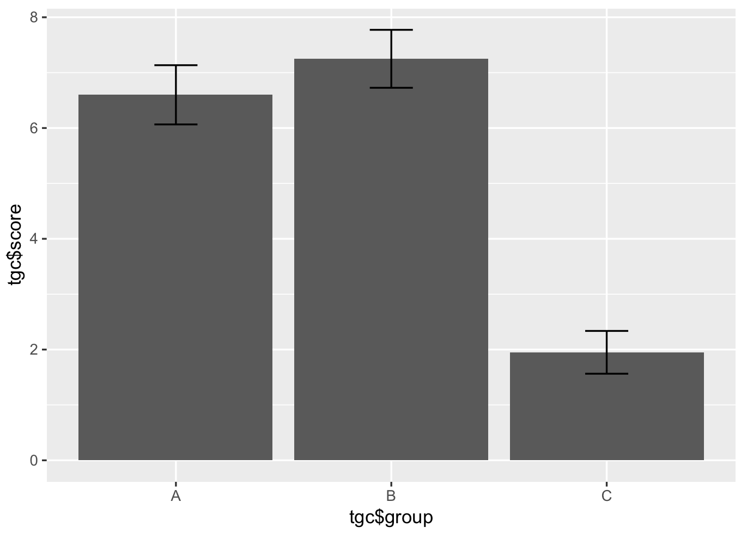

Slide 89
ok we have learned quite a lot so far!

Slide 90
1
5
research question / hypothesis?
look at raw data
2
6
in(dependent) variables?
look at distributions
3a
within or between subjects?
7a
we will see why
check for normality
3b
counterbalancing?
7b
run some stats
T-test if 2 group
ANOVA if more
4
8
how many repetitions/trials?
conclude

Slide 91
let’s talk about dependent variables

Slide 93
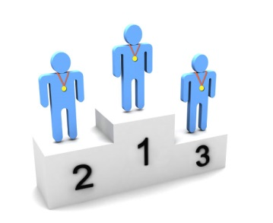

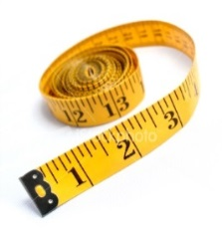


Slide 94
Q1: What is your favourite subject?
Q2: Gender:
Q3: I consider myself to be good at mathematics:
Q4: Score in a recent mock GCSE maths exam:
Maths | English | Science | Art | French
Male | Female
Strongly Disagree | Disagree | Not Sure | Agree | Strongly Agree
Score between 0% and 100%

Slide 95
Nominal
Q1: What is your favourite subject?
Q2: Gender:
Q3: I consider myself to be good at mathematics:
Q4: Score in a recent mock GCSE maths exam:
Maths | English | Science | Art | French
Male | Female
Binary/ Nominal
Strongly Disagree | Disagree | Not Sure | Agree | Strongly Agree
Ordinal
Score between 0% and 100%
Scale

Slide 96
time and error as dependent variables …

Slide 97
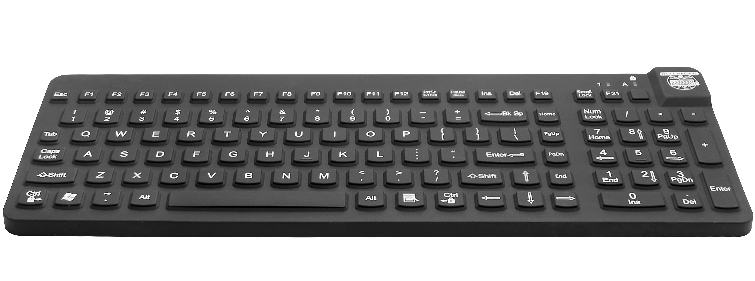
imagine an experiment:
when you hear letter, press the corresponding keys as fast as possible
if there is no penalty for error, participants just slam the keyboard randomly
→ we also need to consider error rate. → each trial is effectively a (time, error) pair

Slide 98
task time
which participant was better?
P2
P1
P1
p2 is worse than any participant in this rectangle
error

Slide 99
task time
which participant was better?
task time and error rate
form a trade-off
P1
P2
error

Slide 100
how to make sure two
conditions can be compared?
task time
4%
control error rate, e.g. pick an error rate in advance, say 4%
or keep task time constant (less common e.g. metronome study [Wobbrock & Cutrell])
P1
P2
error

Slide 101
questionnaires as dependent variables …

Slide 102
Goal is to collect information that is:
Valid
measures the quantity that is supposed to be measured
Reliable
measures the quantity in consistent/reproducible manner
Unbiased
measures the quantity in a way that does not systematically
under- or overestimate the true value
Discriminating
can distinguish adequately between respondents for whom the
underlying level of the quantity or concept is different

Slide 103
How many cups of coffee or tea do you drink in a day?
No, ask for an answer in only one dimension, separate the question into two
(1) How many cups of coffee do you drink during a typical day?
(2) How many cups of tea do you drink during a typical day?

Slide 104
What brand of computer do you own?
(A) IBM PC
(B) Apple
Avoid hidden assumptions
Make sure to accommodate all possible answers
Make each response a separate dichotomous item
Do you own an IBM PC? (Circle: Yes or No)
Do you own an Apple computer? (Circle: Yes or No)
Or allow for multiple responses
What brand of computer do you own? (Circle all that apply)
Do not own computer
IBM PC
Apple
Other

Slide 105
Have you had pain in the last week?
[ ] Never [ ] Seldom [ ] Often [ ] Very often
Make sure question and answer options match
Reword either question or answer to match
How often have you had pain in the last week?
[ ] Never [ ] Seldom [ ] Often [ ] Very Often

Slide 106
Where did you grow up?
Country
Farm
City
Avoid questions having non-mutually exclusive answers
Design the question with mutually exclusive options
Where did you grow up?
House in the country
Farm in the country
City

Slide 107
Which one of the following do you think increases a person’s chance of having a heart attack the most? (Check one.)
[ ] Smoking [ ] Being overweight [ ] Stress
Encourage to consider each possible response to avoid the uncertainty of whether a missing item may represent either an answer that does not apply or an overlooked item
Which of the following increases the chance of having a heart attack?
Smoking: [ ] Yes [ ] No [ ] Don’t know
Being overweight: [ ] Yes [ ] No [ ] Don’t know
Stress: [ ] Yes [ ] No [ ] Don’t know

Slide 108
On a scale from 1 to 5, how fun did you have using our new system?
1. not at all 2. Not really 3.undecided 4. somewhat 5. very much
Avoid biased questions
Design the question with mutually exclusive options
On a scale from 1 to 5, how would you rate your experience with our new system?
1. not fun at all 2. Not really fun 3.undecided 4. somewhat fun 5. very much fun

Slide 109
Rank from 1 to 3 your preference in beverage
[ ] Tea [ ] Coffee [ ] Orange Jus
Avoid ranking at all cost and rather use Likert scales
On a scale from 1 to 5 rate how much you like the following beverages
Tea: 1. not at all 2. Not really 3.undecided 4. somewhat 5. very much
Coffee: 1. not at all 2. Not really 3.undecided 4. somewhat 5. very much
Orange jus: 1. not at all 2. Not really 3.undecided 4. somewhat 5. very much

Slide 110
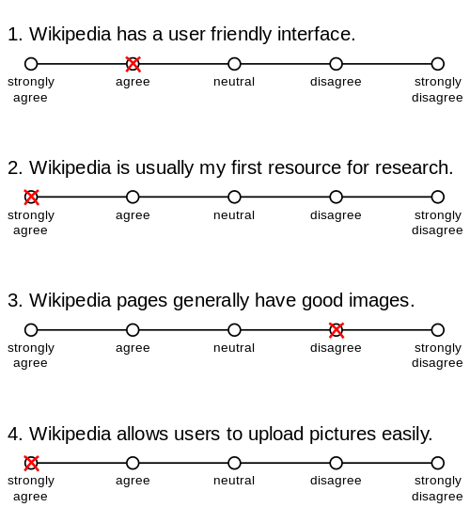
if you want to collect subjective metric such as opinions, use Likert Scale = ordinal but treated as continuous variable

Slide 111
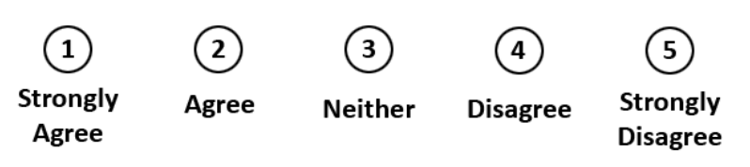
Likert scale::
psychometric response scale primarily used in questionnaires to obtain participant’s preferences or degree of agreement with a statement (generally 5pt likert scale, also 7pt)

Slide 112
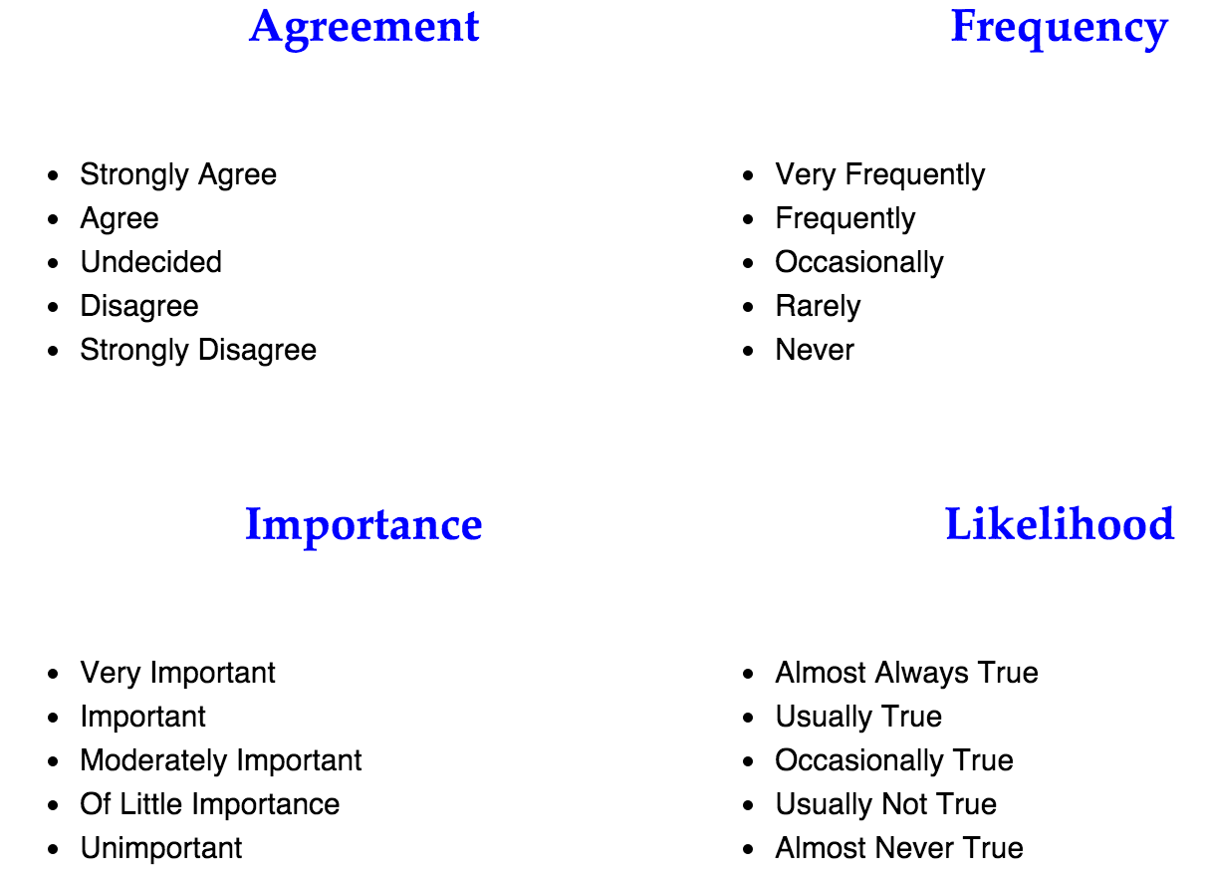

Slide 113
ok so there are many type of data and so what?

Slide 114
so far we played with data (time, errors, memo)
that tends to follow curve of normal distribution (typical of human performances)
you could also deal with data
that tends not to follow a normal distribution (e.g. Likert scale surveys)

Slide 115

bad news: we cannot use Ttest and Anova

Slide 116
use parametric tests (ttest, anova)
so far we played data (time, errors, memo)
that tends to follow curve of normal distribution (typical of human performances)
you could also deal with data
that tends not to follow a normal distribution (e.g. Likert scale surveys)
use non-parametric tests

Slide 117
continuous independent variable
What type of data?
discrete independent variable
continuous dependent variable
discrete dependent variable
Continuous dependent variable
Discrete/categorical dependent variable
regressions
logistic
regressions
normally distributed
skewed
2 grp
>2 grp
2 grp
>2 grp
2 grp
>2 grp
Non paired
paired
Non paired
paired
Non paired
paired
Non paired
paired
Counts >= 5 in >= 75% cells
Counts >= 5 in < 75% cells
T-test
ANOVA
Mann-Whitney Utest
Wilcoxon signed rank test
Kruskall-Wallis test
Chi-square test
Fisher’s exact test
Chi-square test
Paired-t-test
Friiedman test
McNemar’s test

Slide 118
continuous independent variable
What type of data?
discrete independent variable
continuous dependent variable
discrete dependent variable
Continuous dependent variable
Discrete/categorical dependent variable
regressions
logistic
regressions
normally distributed
skewed
2 grp
>2 grp
2 grp
>2 grp
2 grp
>2 grp
Non paired
paired
Non paired
paired
Non paired
paired
Non paired
paired
Counts >= 5 in >= 75% cells
Counts >= 5 in < 75% cells
T-test
ANOVA
Mann-Whitney Utest
Wilcoxon signed rank test
Kruskall-Wallis test
Chi-square test
Fisher’s exact test
Chi-square test
Paired-t-test
Friiedman test
McNemar’s test

Slide 119
continuous independent variable
What type of data?
discrete independent variable
continuous dependent variable
discrete dependent variable
Continuous dependent variable
Discrete/categorical dependent variable
regressions
logistic
regressions
normally distributed
skewed
2 grp
>2 grp
2 grp
>2 grp
2 grp
>2 grp
Non paired
paired
Non paired
paired
Non paired
paired
Non paired
paired
Counts >= 5 in >= 75% cells
Counts >= 5 in < 75% cells
T-test
ANOVA
Mann-Whitney Utest
Wilcoxon signed rank test
Kruskall-Wallis test
Chi-square test
Fisher’s exact test
Chi-square test
Paired-t-test
Friiedman test
McNemar’s test

Slide 120
the best thing to do is to test if your data follow a normal distribution or not first before running the stats
… we will look at this in two lectures

Slide 121
summary

Slide 122
1
5
research question / hypothesis?
look at raw data
2
6
in(dependant) variables?
look at distributions
3a
within or between subjects?
7a
we will see why
check for normality
3b
counterbalancing?
7b
run some stats
4
8
how many repetitions/trials?
conclude

Slide 123
design the experiment in such way that the results will be easy to analyze
be sure you will be able to perform the statistical analysis
there are many R tutorials online!

Slide 124
take away
Explain the eight steps to design and analyze an experiment
Explain what is a within or between subject experiment
Explain what is a controlled variable or a confounding variable
Explain the difference between correlation and causality
Identify different types of variables
Understand when to use a t-test, when to use an Anova
Explain what is a Likert scale in questionnaires
Explain when to use non-parametric tests

Slide 125
end

